Slide 1
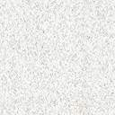
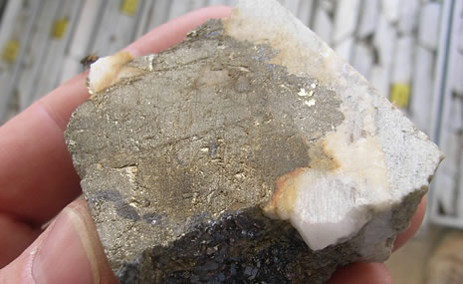

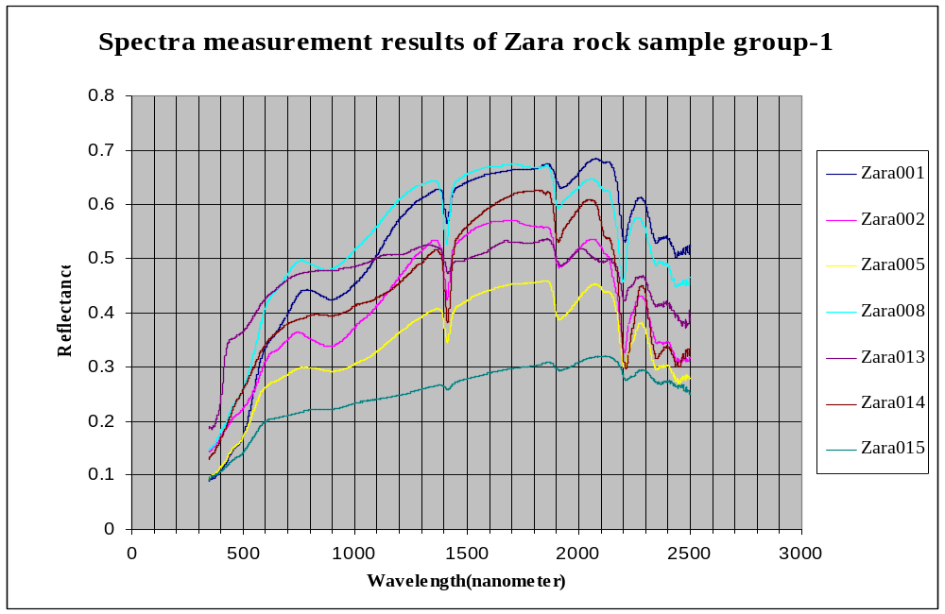
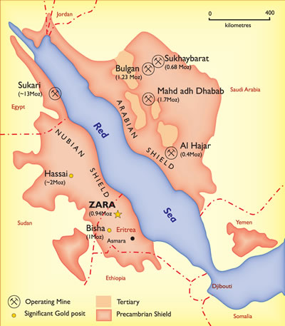
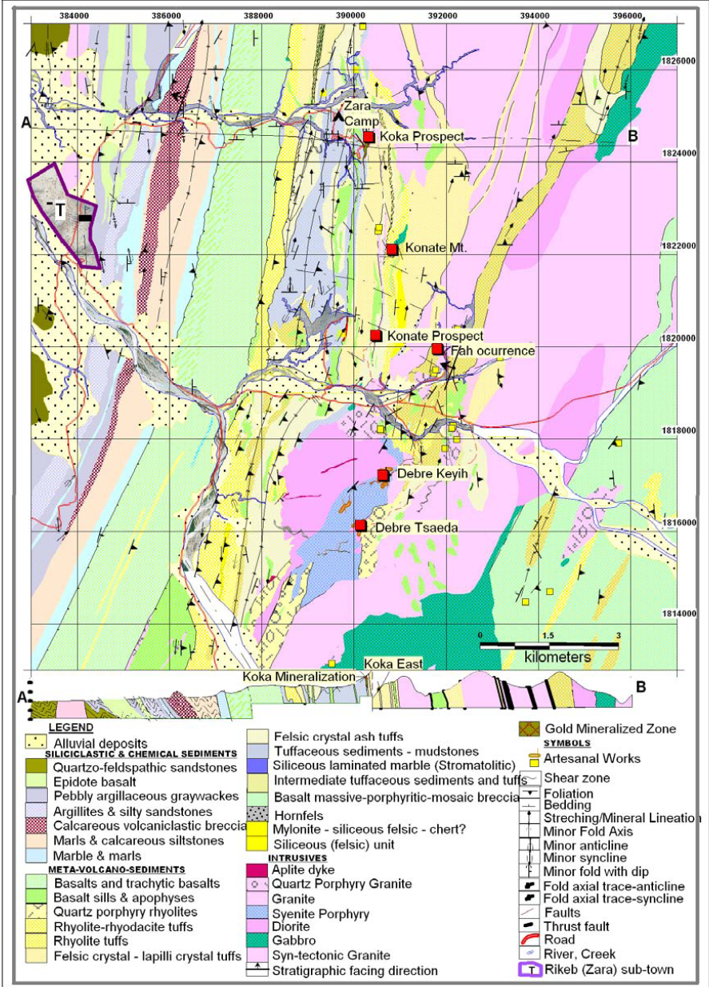
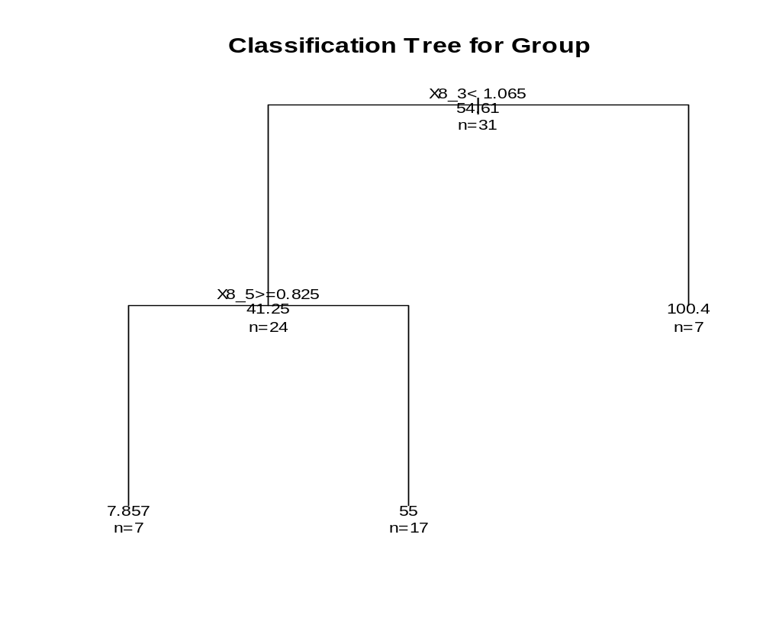
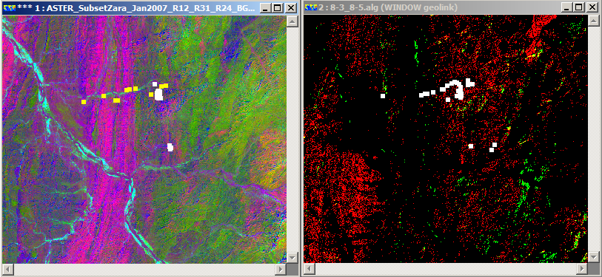
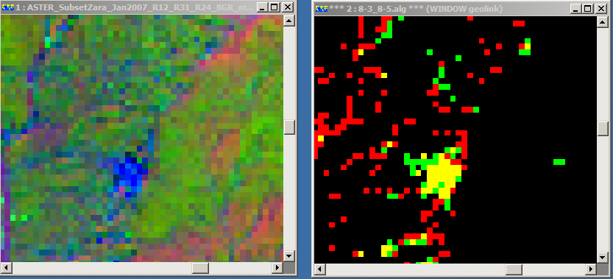
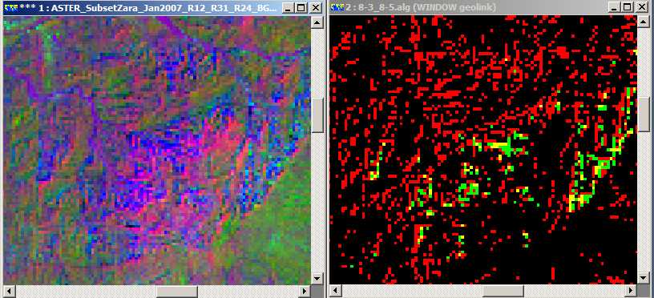
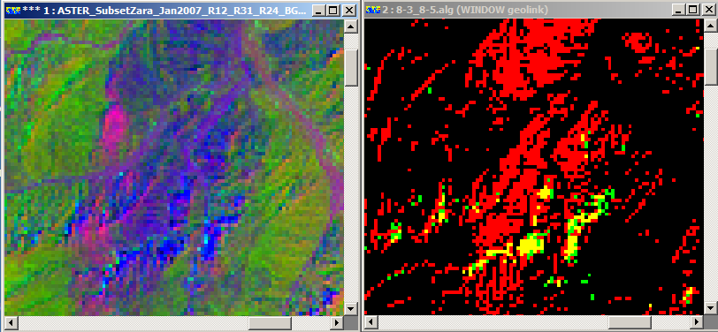
    Discovering the Possible Source of Copper Concentrations within Zara Gold
    Prospect, Eritrea Using ASTER band ratios and R Statistical Analysis
    Benhur B. Tedros and Peter V. Gorsevski
    Department of Geology, Bowling Green State University, Bowling Green, OH 43403
Abstract
Results
Different mineral alterations were mapped in Zara gold prospects using ASTER band ratios and ratio codes, and 31 rock chips from the study area were collected and analyzed to find out any relationship with the mapped mineral alterations especially malachite (CuCo3(OH)3). Ten characteristic ASTER band ratios were selected to be analyzed using R statistical programming language. Malachite alteration was used for comparison with the copper data because it is composed of copper element and is common in the Zara gold prospect. For validation purpose, ratios of R(1,2), R(3,1) and R(2,4), which were not part of the 10 ratios, were selected and displayed as blue, green and red respectively to show malachite alteration as blue because malachite has 9, 0, 0 ratio codes in the above combination sequence. The result of R shows that 8/3 and 8/5 were found to be unique ratios to develop the classification tree for the copper concentration. The area with a ratio of (8/3)>=1.065 is classified with the highest mean copper concentration (100.4ppm) in which seven of the observations lie within this range. Using the rest observations, another higher concentration( 55ppm) was also given to an area which has a ratio of (8/5) < 0.825. At last, binary map of areas with these two higher concentration was prepared, which later was validated with the mapped malachite of ASTER ratio image and showed a good fit.
ASTER Band ratio image and the classified copper concentration area were mapped
The higher copper concentrations area, which are resulted from the classification tree, were displayed as red and green layers within the ASTER imagery of the study area
The presence of yellowish pixels refer to the intersection of the red and green layers, which also give higher confidence for the higher copper concentration. Thus, the yellowish pixels were chosen for the above reason.
As the figures show, the area classified with higher copper concentrations( yellowish pixels) lies within the mapped malachite alteration.
Spectra measurement of some of the Zara rock samples
Major gold deposits in the region where the study area is located
Geological Map of Zara Gold Prospects
Classification tree for Cu concentrations and the 10 ASTER ratios values for the 31 rock chips
Conclusions
The results exhibit the robustness of ASTER (multispectral satellite imagery), band ratio, ratio codes and the R statistical programming language
The results proved that the mapped minerals using band ratios and ratio codes could also be compared with gold content of the rock chips from the study area (if data was available) to identify the minerals associated with the gold mineralization.
Advanced statistical method ( R package in this case) also proved that data, which shows weak relationships with a given variable, can be easily explored and analyzed using the above software.
(Left) ASTER band ratio image of R(1,2), R(3,1) and R(2,4) which displays malachite alteration as blue color. (Right) Mapped area with the higher mean concentrations of Cu resulted from the classification tree{[R(8/3)>=1.065]=Red; [R(8/5) < 0.825] = Green; [Red + Green ]= Yellow}
Ten characteristic ASTER spectral band ratios were selected and copper concentrations were extracted from the 31 collected rock chips from the study area.
R(1,2), R(3,1) and R(2,4) were used to map malachite, which shows 9, 0, 0 ratio code value in the developed Perry and Vincent(2009) ratio codes for different minerals.
R statistical programming language was utilized, and ERmapper 7 were used for mapping and classification
Study Approach
Three pair of ASTER ratio images for malachite taken from different part of the study area and compared to the classified higher copper concentrations developed using classification tree of R software package. Blue refers to malachite; and yellow refers to the combination of red and green pixels, which refer to the mapped areas with the probability of higher copper concentration. The higher Cu concentration area matched with the mapped malachite mineral( CuCo3(OH)).

